Slide 1


Imcgd214-Managing games production Imcgd111-Group project L4/5 GROUP 2
Jordan Marks
Alice Baker
Thomas Gibbs
Daniel Pokladek

Slide 2
The brief
Physics based game
Easy to learn game yet hard to master
Adversarial Gameplay.
Symmetrical gameplay.
J

Slide 3
Logline and target audience
Logline – Beat your Foes in this gravity based planetary arena.
Target audience – 18-35 Male and Female
Platform – Mobile
J

Slide 4
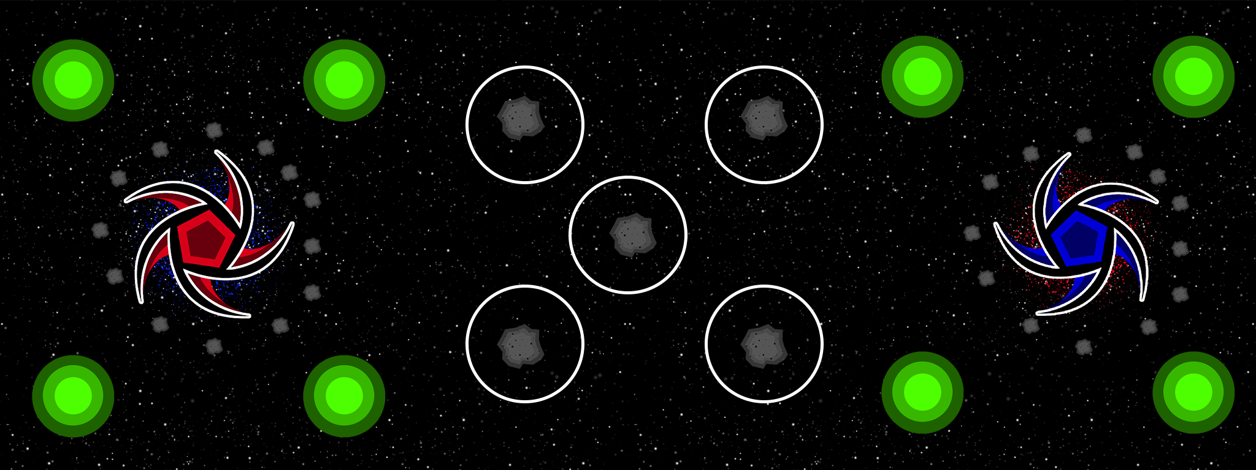
Game
What the player does
Physics in the game
Turn based game play
TD

Slide 5
Prototype
https://www.youtube.com/watch?v=qWnF1_omOyY&feature=youtu.be
TD

Slide 6
how the game meets the brief
Two player –
Adversarial Gameplay.
Symmetrical gameplay.
Physics -
Gravity wells.
J

Slide 7
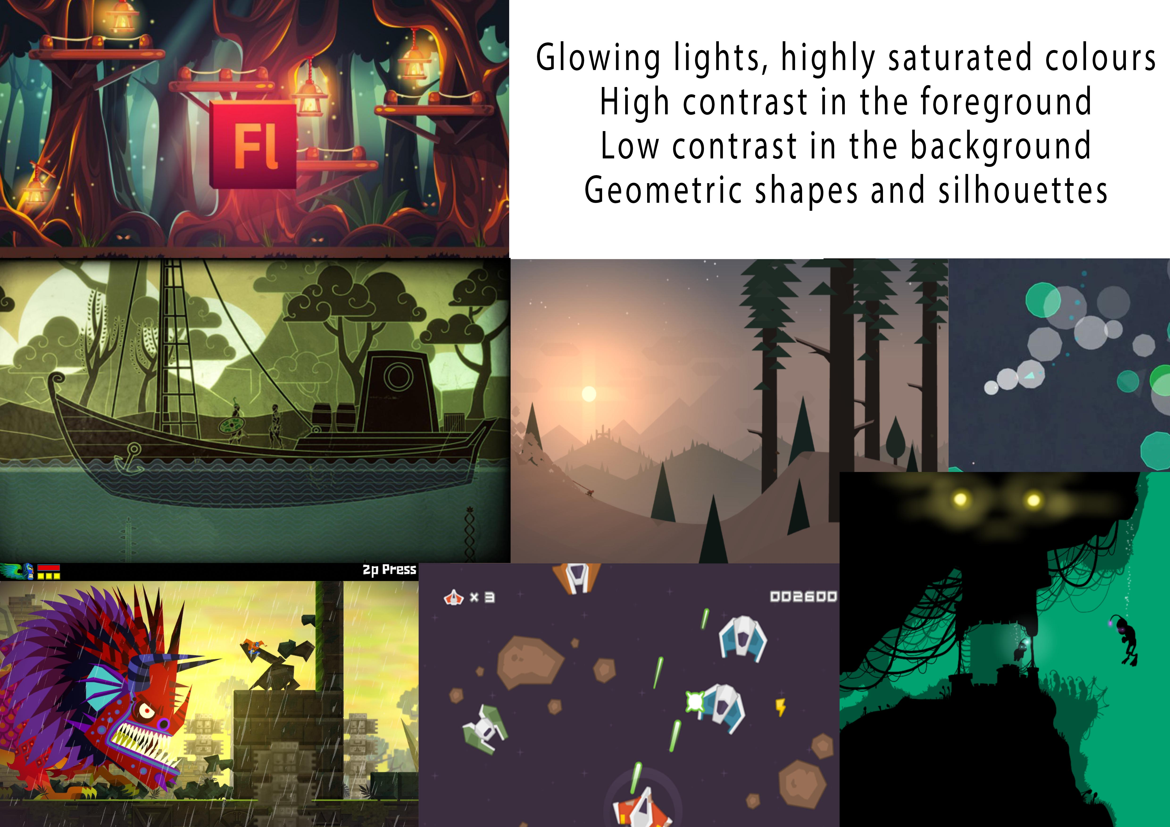
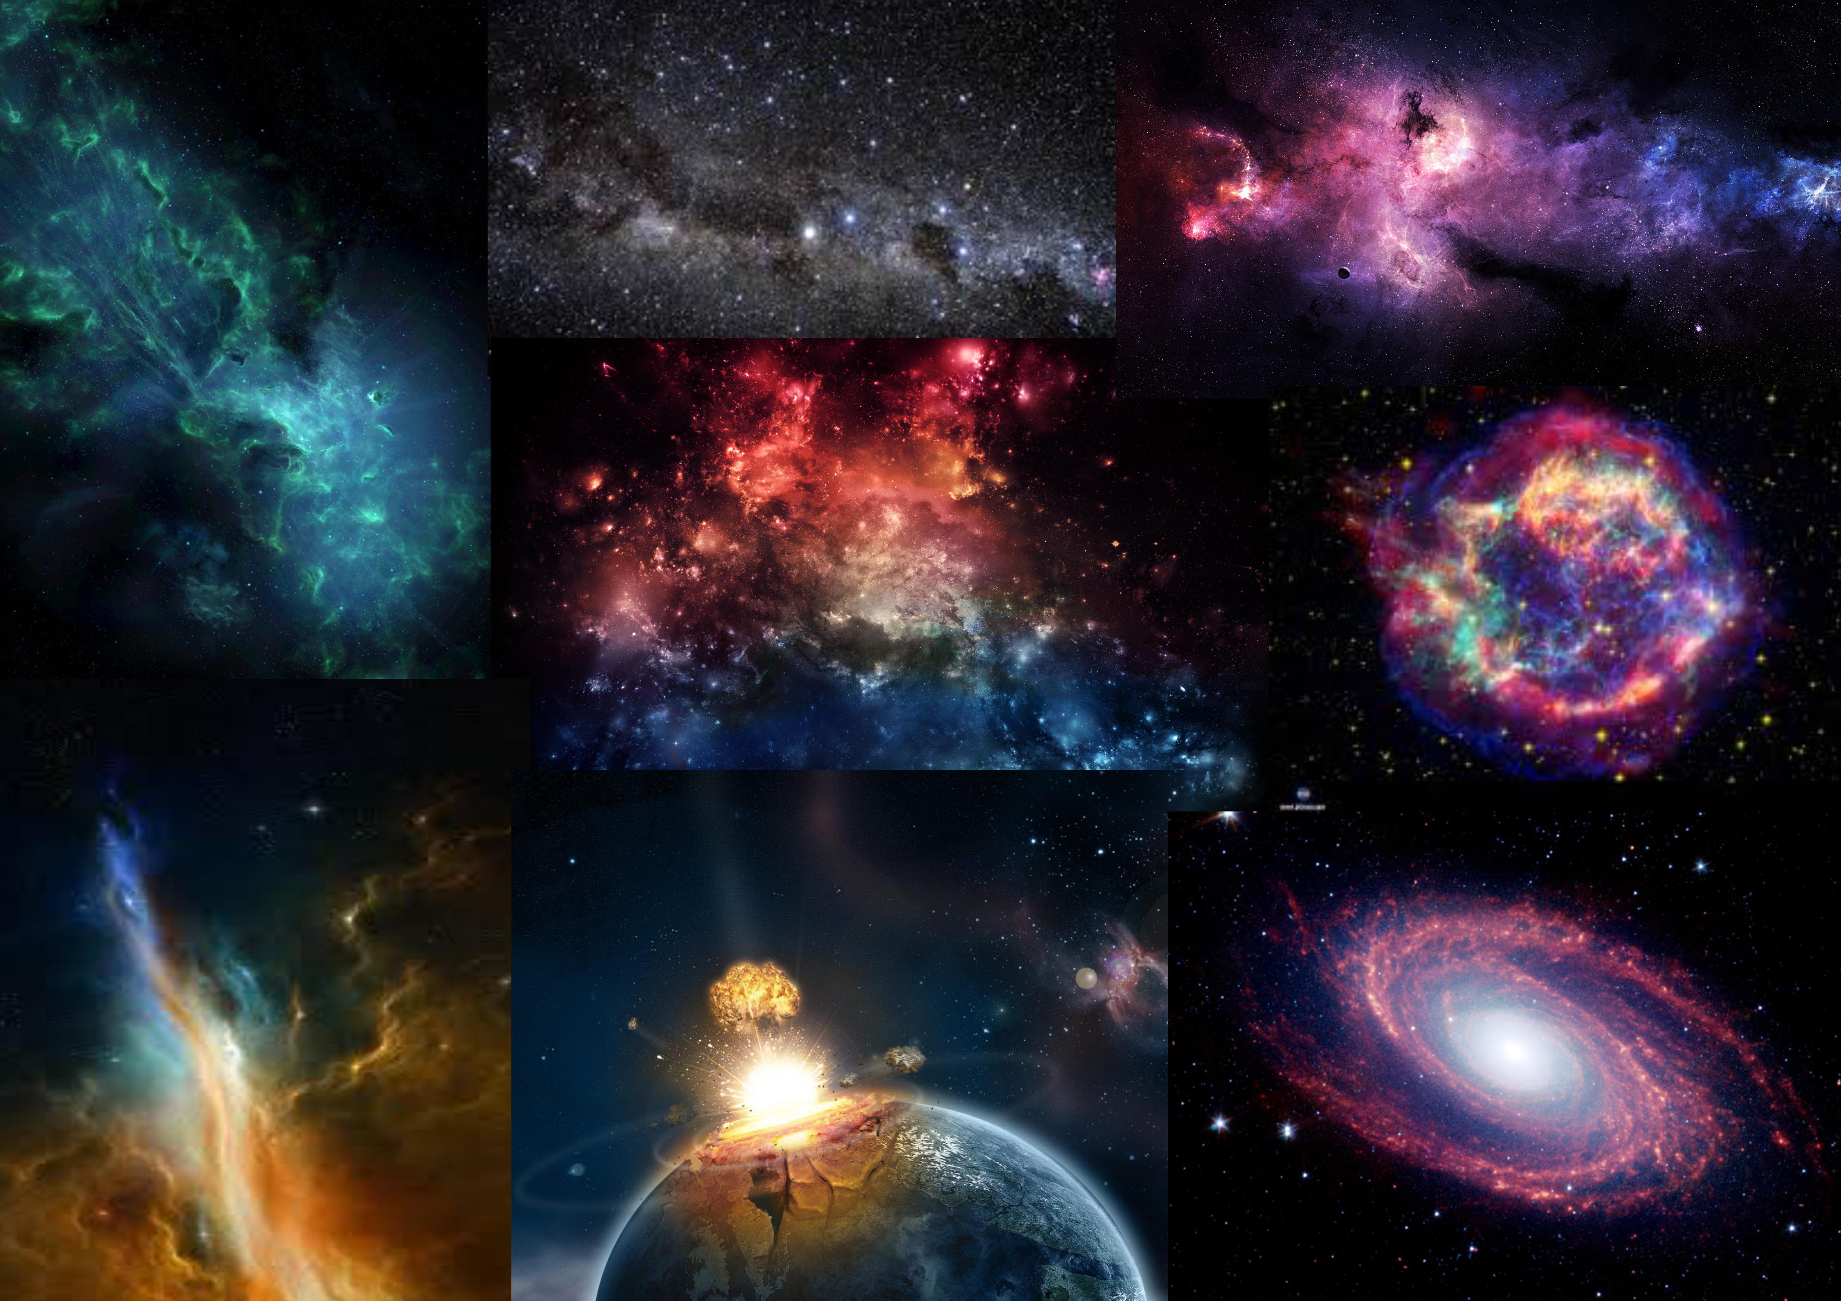
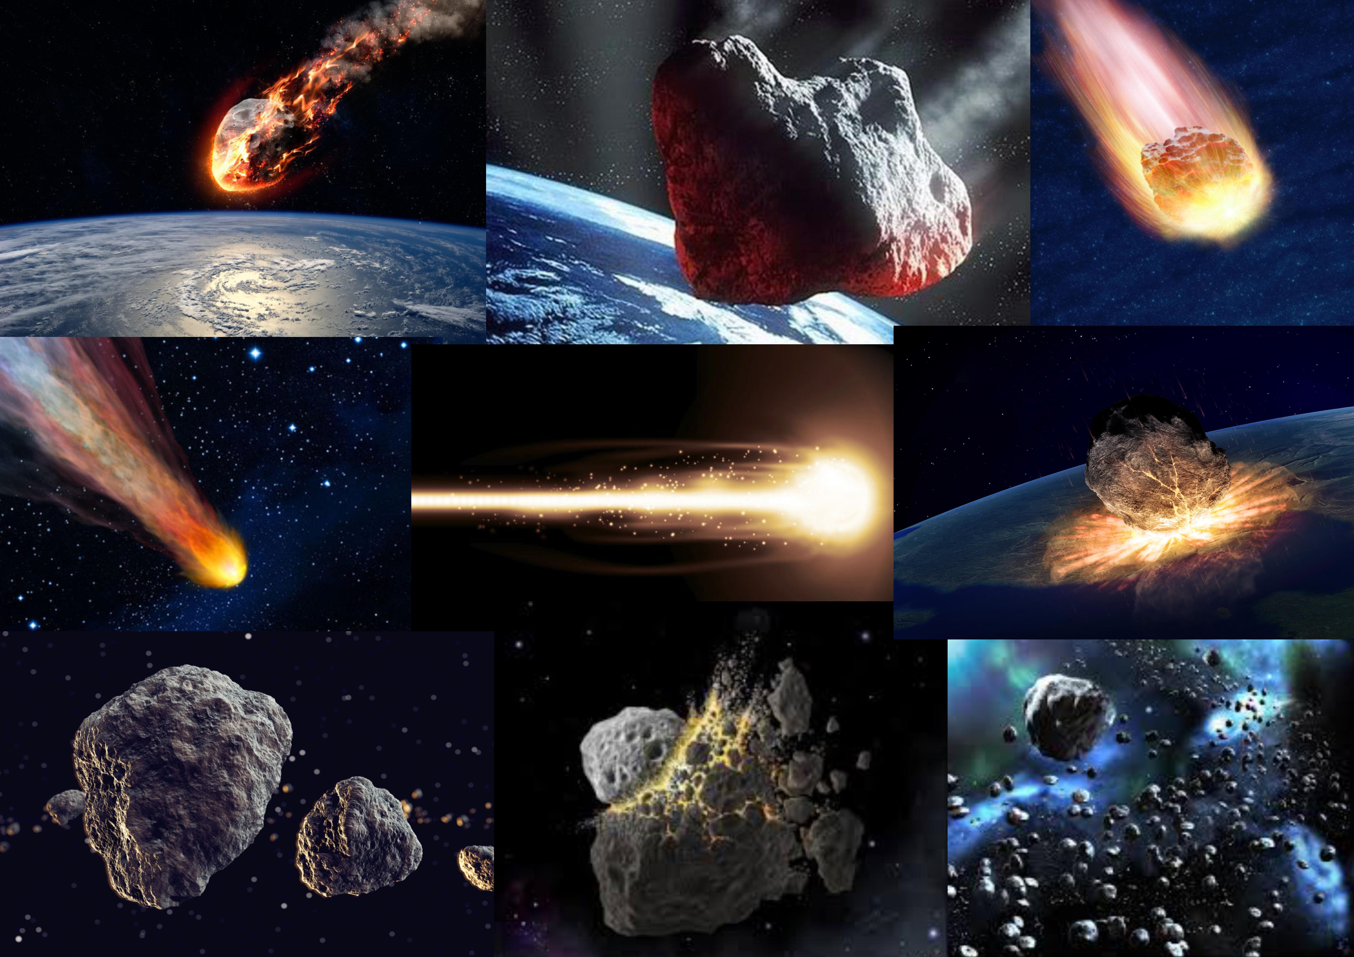

Art style and Moodboard
A

Slide 8

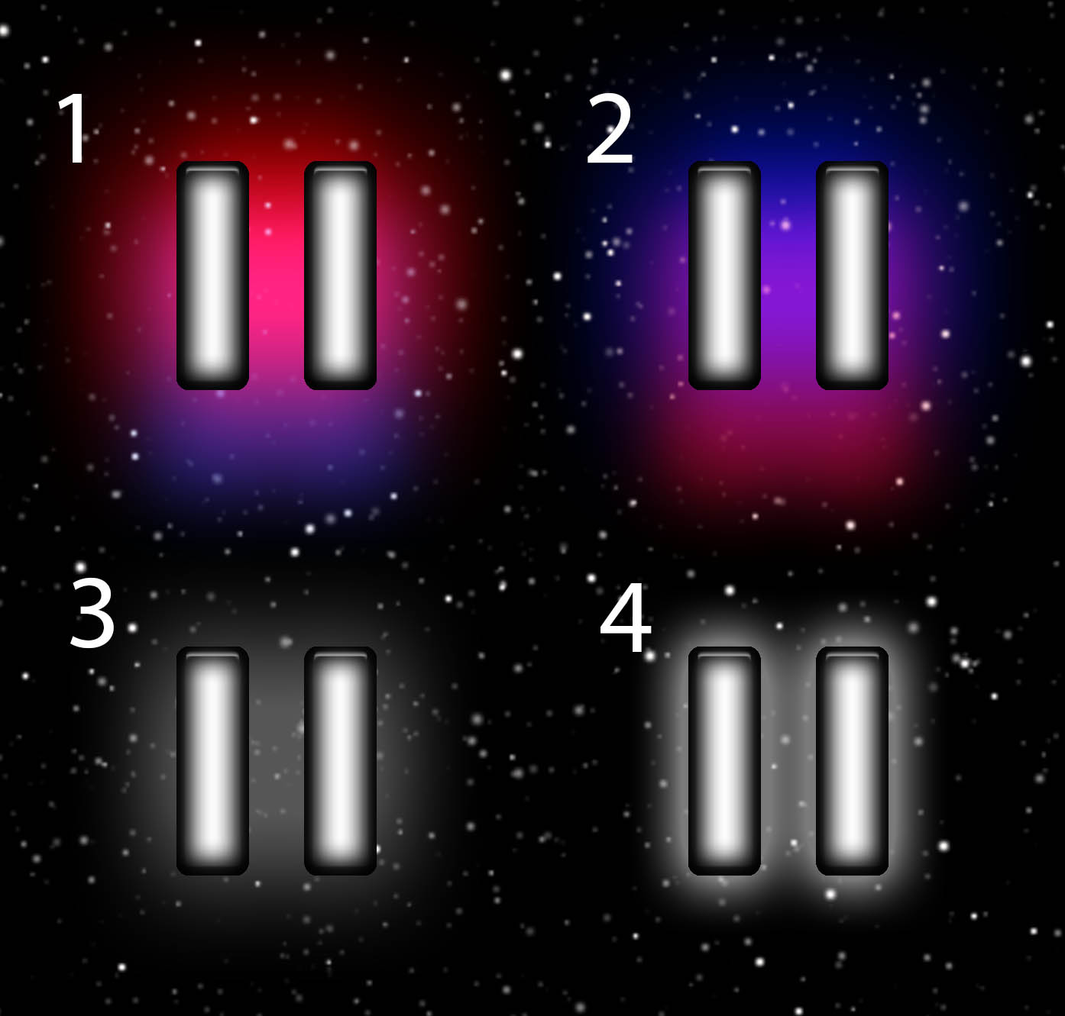
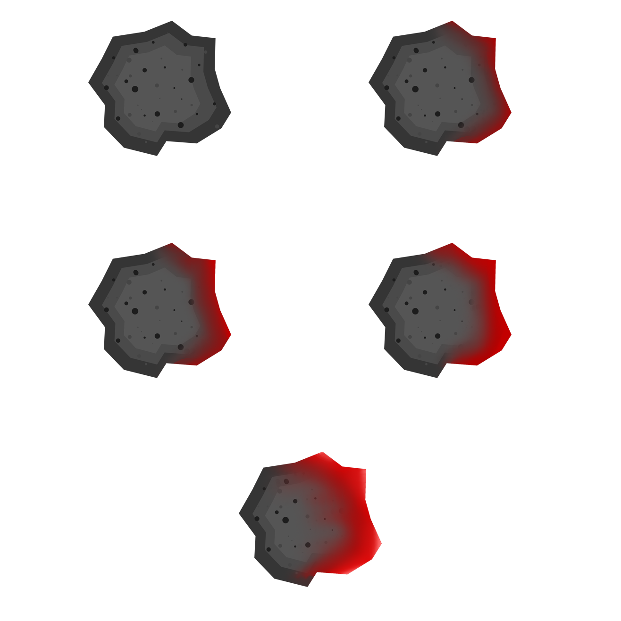









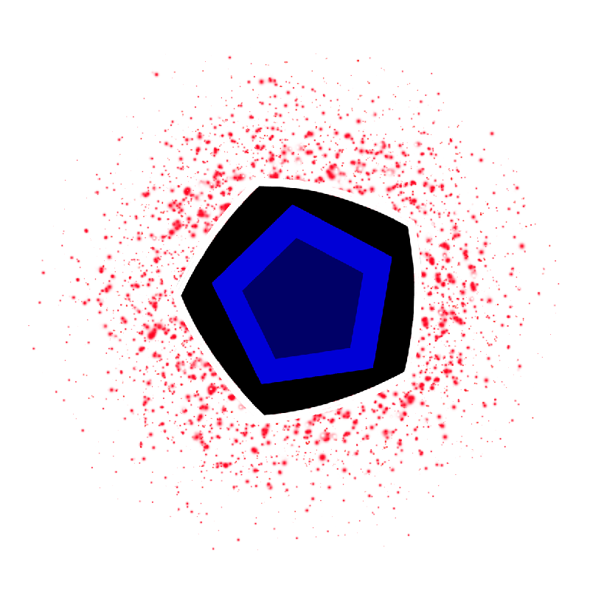
Game art
A

Slide 9
What we will deliver at the end of the project?
Fully playable Prototype of the game
Game have been Playtested by the most players we can.
J

Slide 10
What we have left to do to achieve this?
Playtesting
Finalize the Art
Finalize The Code.
J

Slide 11
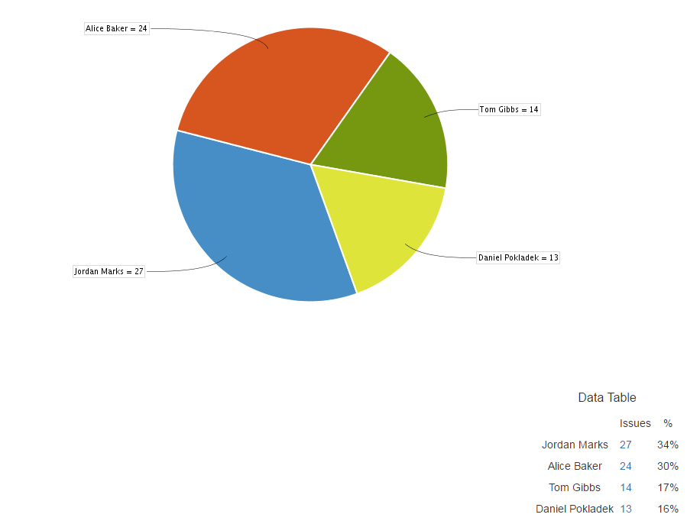
management
Emails (For the last for 4 weeks)
Jordan - 40 (12)
Alice - 24 (7)
Dan - 15 (5)
Tom - 13 (4)
Hours (For the last for 4 weeks)
Jordan - 42 Hours (20 Hours)
Alice - 44 Hours (21 Hours)
Dan - 43 Hours (16 Hours)
Tom - 43 Hours (17 Hours)
Tasks by person (For all weeks of the project.)
J

Slide 12
Questions?

